Slide 1
Limited Dependent Variable Models and Sample Selection Corrections

Slide 2
Limited Dependent Variable Models and Sample Selection Corrections
Limited dependent variables (LDV)
  LDV are is substantively restricted
    Binary vavariables whose range riables, e.g. employed/not employed
    Nonnegative variables, e.g. wages, prices, interest rates
    Nonnegative variables with excess zeros, e.g. labor supply
    Count variables, e.g. the number of arrests in a year
    Censored variables, e.g. unemployment durations
Sample selection models
  The sample used to infer population relationships is endogenously selected, e.g. wage offer regression but data only about working women

Slide 3

Limited Dependent Variable Models and Sample Selection Corrections
Logit and Probit models for binary response
Disadvantages of the LPM for binary dependent variables
  Predictions sometimes lie outside the unit interval
  Partial effects of explanatory variables are constant
Nonlinear models for binary response
  Response probability is a nonlinear function of explanat. variables
Probability of a “success” given explanatory variables
A cumulative distribution function
. The response probability is thus a function of the explanatory variables x.
Shorthand vector notation: the vector of explanatory variables x also contains the constant of the model.

Slide 4



Limited Dependent Variable Models and Sample Selection Corrections
Choices for the link function
Latent variable formulation of the Logit and Probit models
Probit: (normal distribution)
Logit: (logistic function)
and
If the latent variable y* is larger than zero, y takes on the value 1, if it is less or equal zero, y takes on 0 (y* can thus be interpreted as the propensity to have y = 1)

Slide 5
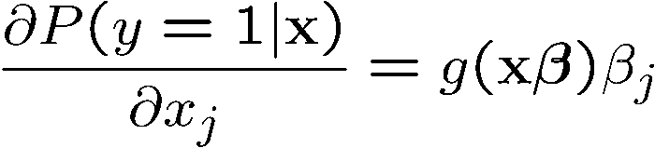

Limited Dependent Variable Models and Sample Selection Corrections
Interpretation of coefficients in Logit and Probit models
Partial effects are nonlinear and depend on the level of
Continuous explanatory variables:
where
How does the probability for y = 1 change if explanatory variable x_{j} changes by one unit?
Discrete explanatory variables:
For example, explanatory variable x_{k} increases by one unit.

Slide 6
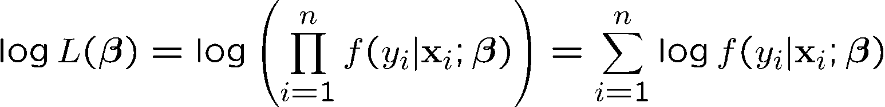
Limited Dependent Variable Models and Sample Selection Corrections
Maximum likelihood estimation of Logit and Probit models
Properties of maximum likelihood estimators
  Maximum likelihood estimators are consistent, asymptotically normal, and asymptotically efficient if the distributional assumptions hold
The probability that individual i‘s outcome is y_{i} given that his/her characteristics are x_{i}
Under random sampling
= Maximum likelihood estimates

Slide 7
Limited Dependent Variable Models and Sample Selection Corrections
Hypothesis testing after maximum likelihood estimation
  The usual t-tests and confidence intervals can be used
  There are three alternatives to test multiple hypotheses
    Lagrange multiplier or score test (not discussed here)
    Wald test (requires only estimation of unrestricted model)
    Likelihood ratio test (restricted and unrestricted models needed)
Chi-square distribution with q degrees of freedom
The null hypothesis that the q hypotheses hold is rejected if the growth in maximized likelihood is too large when going from the restricted to the unrestricted model

Slide 8


Limited Dependent Variable Models and Sample Selection Corrections
Goodness-of-fit measures for Logit and Probit models
  Percent correctly predicted
  Pseudo R-squared
  Correlation based measures
Individual i‘s outcome is predicted as one if the probability for this event is larger than .5, then percentage of correctly predicted y = 1 and y = 0 is counted
Compare maximized log-likelihood of the model with that of a model that only contains a constant (and no explanatory variables)
Look at correlation (or squared correlation) between predictions or predicted prob. and true values

Slide 9

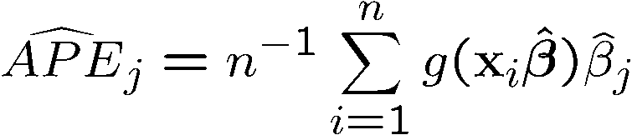
Limited Dependent Variable Models and Sample Selection Corrections
Reporting partial effects of explanatory variables
  The difficulty is that partial effects are not constant but depend on
  Partial effects at the average:
  Average partial effects:
  Analogous formulas hold for discrete explanatory variables
The partial effect of explanatory variable x_{j} is considered for an “average” individual (this is problematic in the case of explana-tory variables such as gender)
The partial effect of explanatory variable x_{j} is computed for each individual in the sample and then averaged across all sample members (makes more sense)

Slide 10
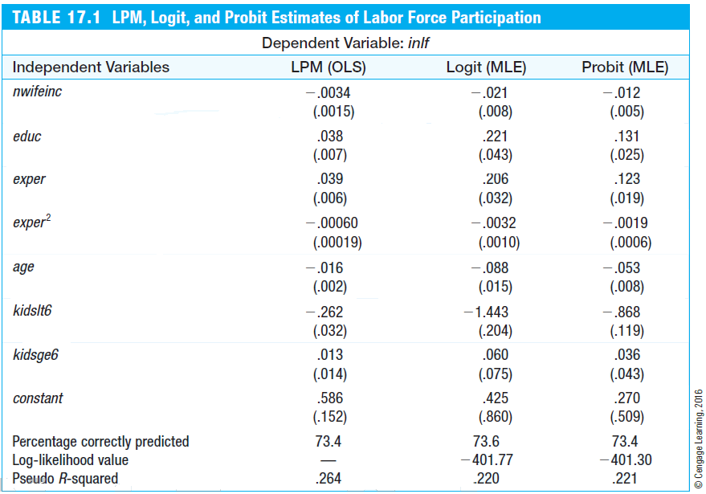
Limited Dependent Variable Models and Sample Selection Corrections
Example: Married women’s labor force participation
The coefficients are not comparable across models
Often, Logit estimated coefficients ¼ is 1.6 times Probit estimated because .
The biggest difference between the LPM and Logit/Probit is that partial effects are nonconstant in Logit/Probit:
(Larger decrease in probability for the first child)

Slide 11

Limited Dependent Variable Models and Sample Selection Corrections
The Tobit model for corner solution responses
  In many economic contexts, decision problems are such that either a positive amount or a zero amount is chosen (e.g. demand for alcohol)
  A linear regression model may be inadequate in such cases as predictions may be negative and effects of explanatory variables are linear
  The Tobit model also makes use of a latent variable formulation
Definition of the Tobit model
Conditional on the values of the explanatory variables, the error term is homoskedastic normally distributed
The final outcome of the dependent variable is positive or zero

Slide 12
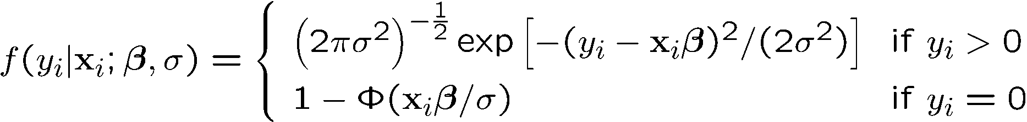

Limited Dependent Variable Models and Sample Selection Corrections
Maximum likelihood estimation of the Tobit model
For positive outcomes, the normal density (applied to ) is used, for zero outcomes the probability is one minus the probability that the latent variable is greater than zero (see Probit).
Maximization of the log-likelihood:
As in the Logit/Probit case, the maximization problem is highly nonlinear. It cannot be solved analy-tically and has to be solved with the help of computer software using e.g. Newton-Raphson methods.

Slide 13

Limited Dependent Variable Models and Sample Selection Corrections
Interpretation of the coefficients in the Tobit model
Conditional mean for all outcomes:
The mean for all outcomes is a scaled version of the mean for only the positve outcomes (this is the reason why a regression using only the positive outcomes would yield wrong results)
Conditional mean for positive outcomes:
The mean for only the positive outcomes is the usual linear regression but plus an extra term (this is again a reason why an ordinary linear regression would yield wrong results)
This is the socalled inverse Mills ratio

Slide 14
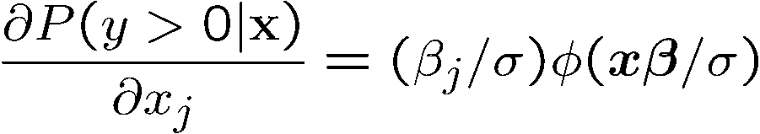
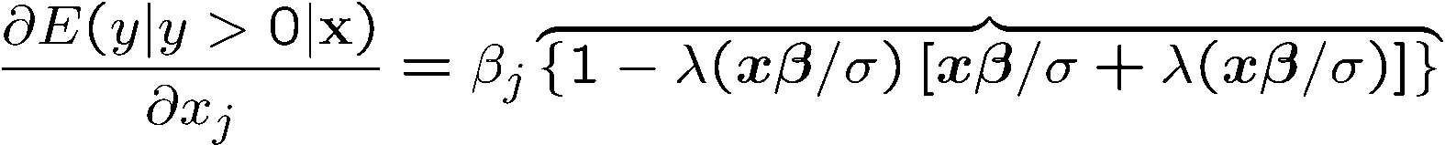
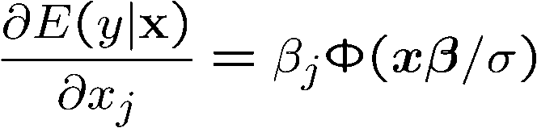
Limited Dependent Variable Models and Sample Selection Corrections
Partial effects of interest in the Tobit model
On the probability for a nonzero outcome:
Note that all partial effects depend on the explanatory variables and the error variance
This adjustment factor can be shown to lie between zero and one
On the mean for positive outcomes:
On the mean of all possible outcomes including zero:
Note that this adjustment factor also lies between zero and one

Slide 15
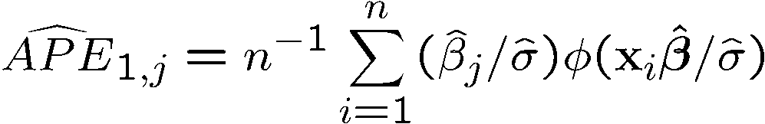
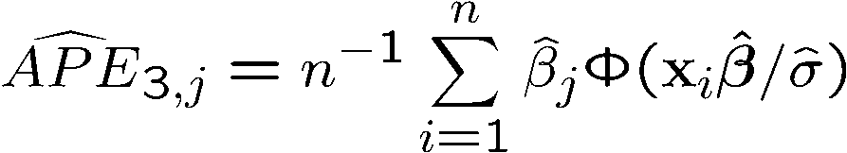
Limited Dependent Variable Models and Sample Selection Corrections
Estimation of average partial effects in the Tobit model
On the probability for a nonzero outcome:
Analogous formulas are available for partial effects at the average (PEA) but they have the afore mentioned disadvantages
On the mean for positive outcomes:
On the mean of all possible outcomes including zero:

Slide 16
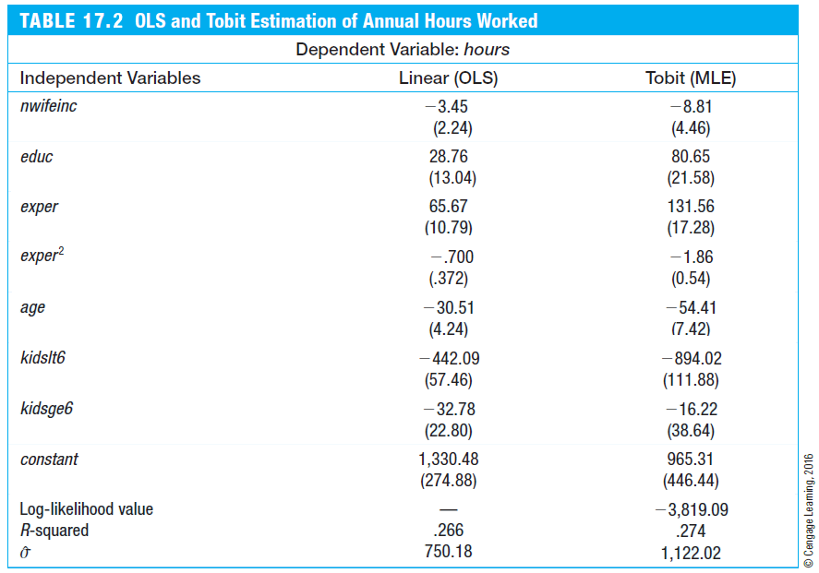
Limited Dependent Variable Models and Sample Selection Corrections
Example: Annual hours worked of married women
Because of the different scaling factors involved, Tobit coefficients are not comparable to OLS coefficients.
To compare Tobit and OLS, one has to compare average partial effects (or partial effects at the average). It turns out that partial effects of Tobit and OLS are different in a number of cases.
Another difference between Tobit and OLS is that, due to the linearity of the model, OLS assumes constant partial effects, whereas partial effects are nonconstant in Tobit.
In the given example, OLS yields negative annual hours for 39 out of 753 women. This is not much but it may be a reason to view the linear model as misspecified.

Slide 17
Limited Dependent Variable Models and Sample Selection Corrections
Specification issues in Tobit/Logit/Probit models
  A restriction of the Tobit model is that explanat. var. influence positive outcomes and the probability of positive outcomes in the same way
  This may be unrealistic in many cases, for example, when modeling the relationship between the amount of life insurance and a person‘s age
  For such cases, more advanced so-called hurdle models can be used
  As in Logit/Probit models, heteroskedasticity may be an issue in Tobit

Slide 18
Limited Dependent Variable Models and Sample Selection Corrections
  ML estimates may be wrong if distributional assumptions do not hold
  There are methods to deal with endogeneity in Logit/Probit/Tobit
  Logit/Probit/Tobit models are also available for panel/time series data

Slide 19

Limited Dependent Variable Models and Sample Selection Corrections
The Poisson regression model for count data
Probability that y takes on the integer value h
Probability function of the Poisson distribution, where
Model the mean of the dependent variable as a function of explanatory variables:
The Poisson regression model models a count variable as a function of explanatory variables:

Slide 20
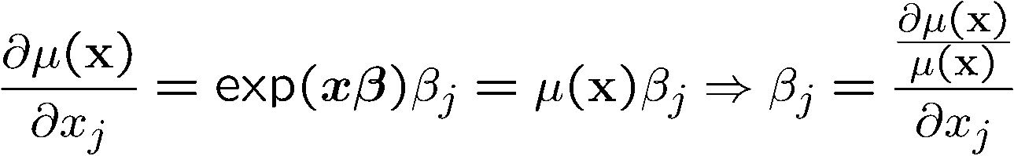

Limited Dependent Variable Models and Sample Selection Corrections
Interpretation of the coefficients of the Poisson regression
Maximum likelihood estimation of the Poisson regression model
  A limitation of the model is that it assumes
  But ML estimators in the Poisson regression model are consistent and asymptotically normal even if the Poisson distribution does not hold
By what percentage does the mean outcome change if x_{j} is increased by one?

Slide 21
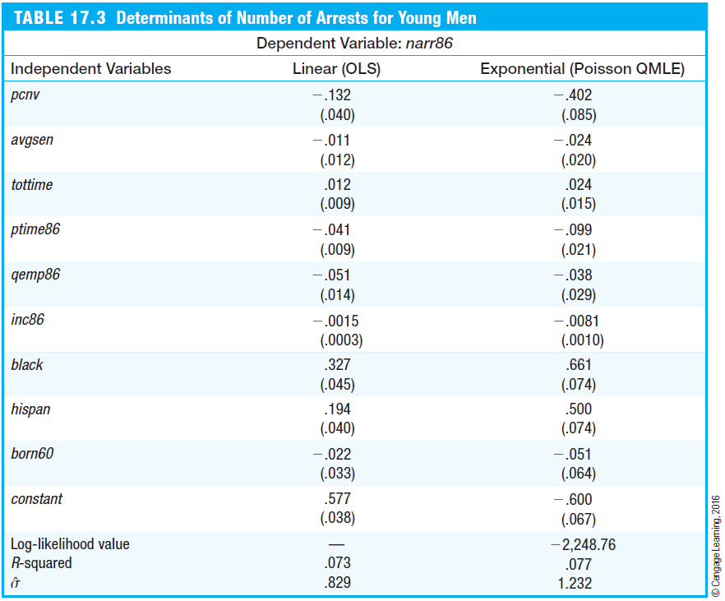

Limited Dependent Variable Models and Sample Selection Corrections
Poisson regression for number of arrests
The expected number of arrests was 2.4 percentage points lower if the average sentence length was 1 month higher.
If the assumption of a Poisson distribution does not hold, ML is still consistent and asymptotically normal. This is called Quasi-Maximum Likelihood estimation (QML).
If the distributional assumptions do not hold and QML is used, standard errors are wrong. One then has to compute robust standard errors (this has not been done here).
Because there is evidence for overdispersion:
This is evidence that the Poisson distribution does not hold and robust standard errors have to be computed. Alternatively one can inflate standard errors by the factor.

Slide 22


Limited Dependent Variable Models and Sample Selection Corrections
The censored regression model
  In many cases, the dependent variable is censored in the sense that values are only reported up to a certain level (e.g. top coded wealth)
  Censored normal regression model:
  Regressing y_{i} on x_{i} would yield correct results but y_{i} is unobserved
  Regressing w_{i} on x_{i} will yield incorrect results (even if only the un-censored observations are used in this regression)
True outcome (unobserved)
Observed outcome
If the true outcome exceeds the censoring threshold, only the threshold is reported

Slide 23
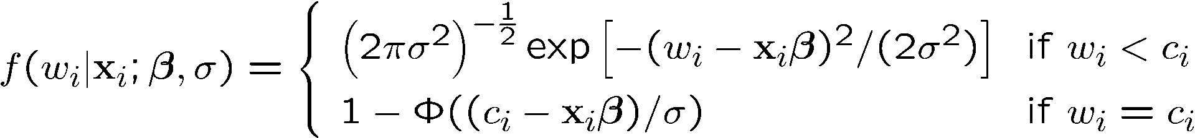
Limited Dependent Variable Models and Sample Selection Corrections
Maximum likelihood estimation of the censored regression model
If the censoring threshold does not bind, the density of the outcome is normal
Probability/density function of observed outcome conditional on explanatory variables:
Maximization of log-likelihood:

Slide 24
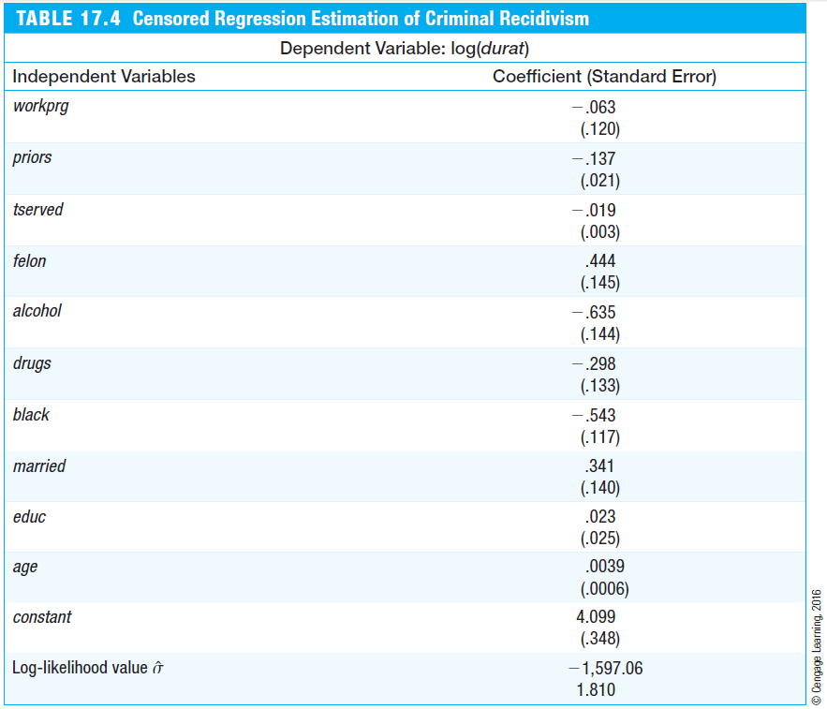
Limited Dependent Variable Models and Sample Selection Corrections
Censored regression estimation of criminal recidivism
The variable durat measures the time in months until a prison inmate is arrested after being released from prison. Of 1,445 inmates, 893 had not been arrested during the time they were followed. Their time out of prison is censored (because its end, if there was one, was not observed).
For example, if the time in prison was one month longer, this reduced the expected duration until the next arrest by about 1.9%.
In the censored regression model, the coefficients can be di-rectly interpreted. This is contrary to the Tobit model, where coefficients cannot be directly interpreted. The censored re-gression model and the Tobit model have a similar structure, but in the Tobit model, the outcome is of a nonlinear nature whereas in the censored regression model, the outcome is linear but incompletely observed.

Slide 25


Limited Dependent Variable Models and Sample Selection Corrections
Truncated regression models
  In a truncated regression model the outcome and the explanatory variables are only observed if the outcome is less or equal some value c_{i}
  In this case, the sample is not a random sample from the population (because some units will never be a part of the sample)
  Truncated normal regression model:
  Applying OLS would not yield correct results because MLR.2 is violated
only observed if

Slide 26
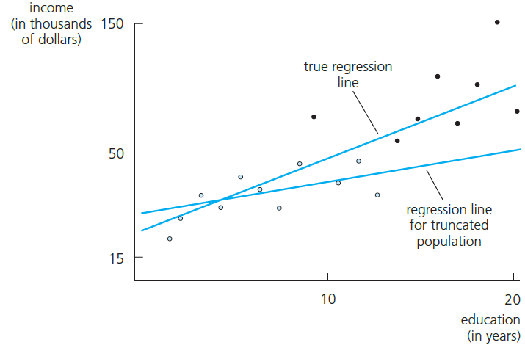
Limited Dependent Variable Models and Sample Selection Corrections
Example: A regression based on a truncated sample
One is interested in the relationship between income and education in the whole population but sampling was done so that only individuals with in-come below $50,000 were sampled.
Direct application of OLS would lead to an underestimation of the slope coefficient because high incomes are omitted.

Slide 27
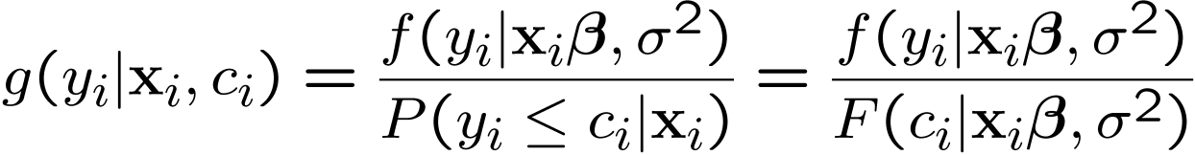


Limited Dependent Variable Models and Sample Selection Corrections
Maximum likelihood estimation of the truncated regression model
As in the censored regression model, nonnormality or heteroskedasticity in the truncated regression model lead to inconsistency
Density of an observed outcome conditional on explanatory variables and the threshold c_{i}:
Likelihood maximization:
Density and distribution function of a normal distribution with mean and variance

Slide 28


Limited Dependent Variable Models and Sample Selection Corrections
Sample selection corrections
  The question is under which assumptions a sample with nonrandom sample selection can be used to infer relationships in the population
When is OLS on the selected sample consistent?
Population model
Sample selection indicator, s_{i} = 1 if obser-vation is part of the sample, s_{i} = 0 otherwise
Regression based on selected sample
Condition for consistency of OLS:

Slide 29
Limited Dependent Variable Models and Sample Selection Corrections
Three cases in which OLS on the selected sample is consistent
  Selection is independent of explanatory variables and the error term
  Selection is completely determined by explanatory variables
  Selection depends on the explanatory variables and other factors that are uncorrelated with the error term
Similar results apply to IV/2SLS estimation
  Instead of for explanatory variables, the conditions have to hold for the full list of exogenous variables that are used in the model
Sample selection and nonlinear models estimated by ML
  Consistency if sample selection is only determined by explanat. var.

Slide 30
Limited Dependent Variable Models and Sample Selection Corrections
Incidental truncation (Heckman model)
Example: Wage offer function using sample of working women
  One is interested in the wage of a woman with certain characteristics would be offered on the labor market if she decided to work
  Unfortunately, one only observes the wages of women who actually work, i.e. who have accepted the wage offered to them
  The sample is truncated because women who do not work (but who would be offered a wage if they asked for it) are never in the sample
  Truncation of this kind is called incidental truncation because it depends on another variable (here: labor force participation)

Slide 31



Limited Dependent Variable Models and Sample Selection Corrections
Definition of Heckman model
Selection bias in OLS
Main equation (e.g. wage equation)
Selection equation (e.g. whether working)
The error terms of both equations are jointly normally distributed (independent of the explanatory variables) with correlation coefficient
For example, if the correlation of unobserved wage determinants and unobserved determi-nants of the work decision is positive, the wo-men observed working will have higher wa-ges than expected from their characteristics (= positive selection)
Running the regression on the truncated sample suffers from omitted variable bias

Slide 32


Limited Dependent Variable Models and Sample Selection Corrections
Estimation of Heckman model
1) Estimation of correction term:
Estimate Probit for work decision using all ob-servations (working and nonworking women)
Calculate inverse Mills ratio using Probit coefficients
2) Include estimated correction term in regression:
If this coefficient is different from zero, there is nonignorable sample selection bias
There have to be explanatory variables in the selection equation that are not in the main equation (exclusion restrictions), otherwise there is multicollinearity because the inverse Mills ratio is almost linear in z

Slide 33
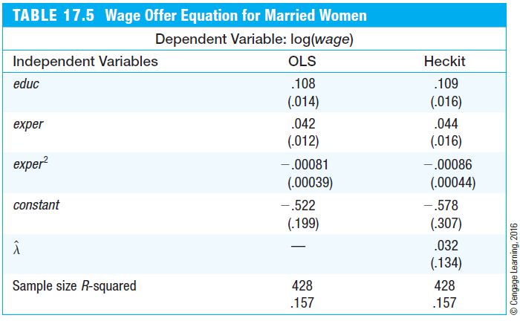
Limited Dependent Variable Models and Sample Selection Corrections
Example: Wage offer equation for married women
The standard errors of the two-step Heckman method are actually wrong and have to be corrected (not done here). One can also use a maximum likelihood procedure.
There is no significant sample selection. This is the reason why OLS and Heckman estimates (“Heckit”) are so similar.

